Slide 1
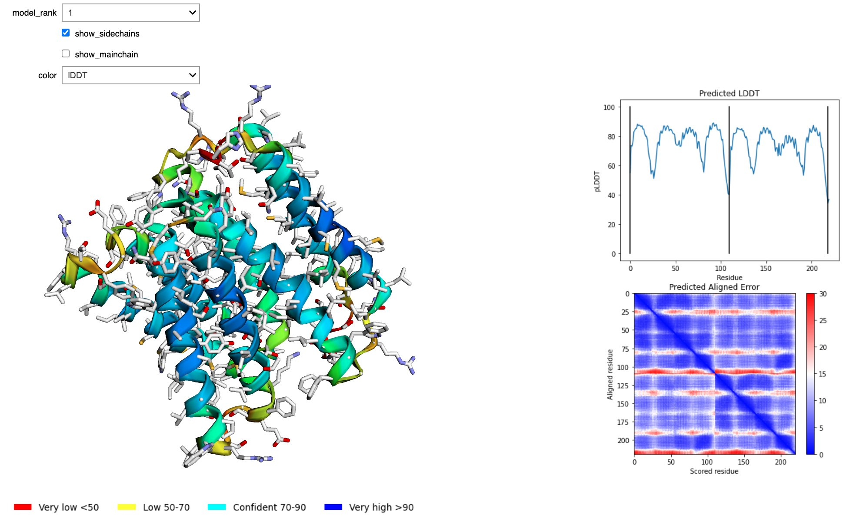
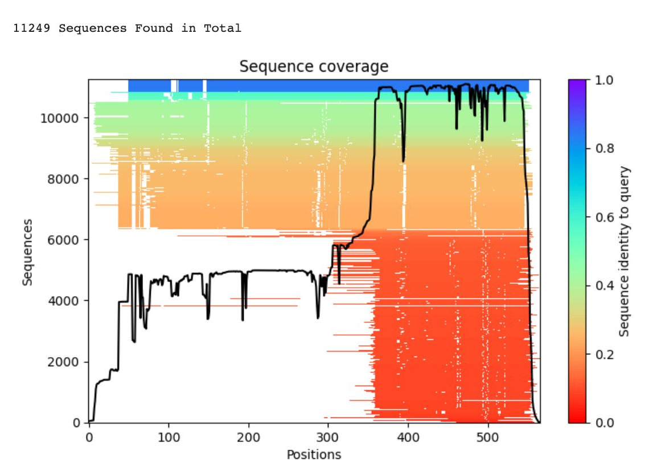
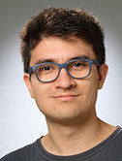


ColabFold
Making Protein folding accessible to all via Google Colab
with
github.com/sokrypton/ColabFold
Milot Mirdita
Martin Steinegger
@milot_mirdita
@thesteinegger

Slide 2
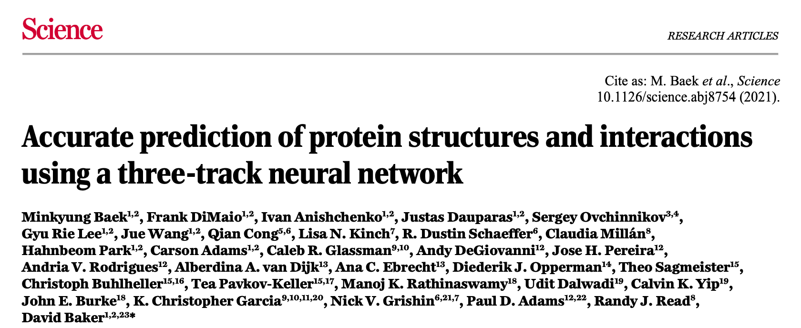
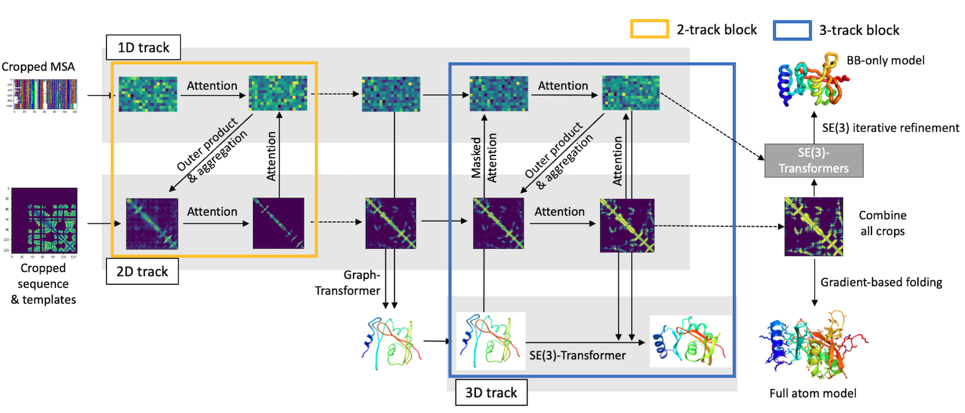

Slide 3
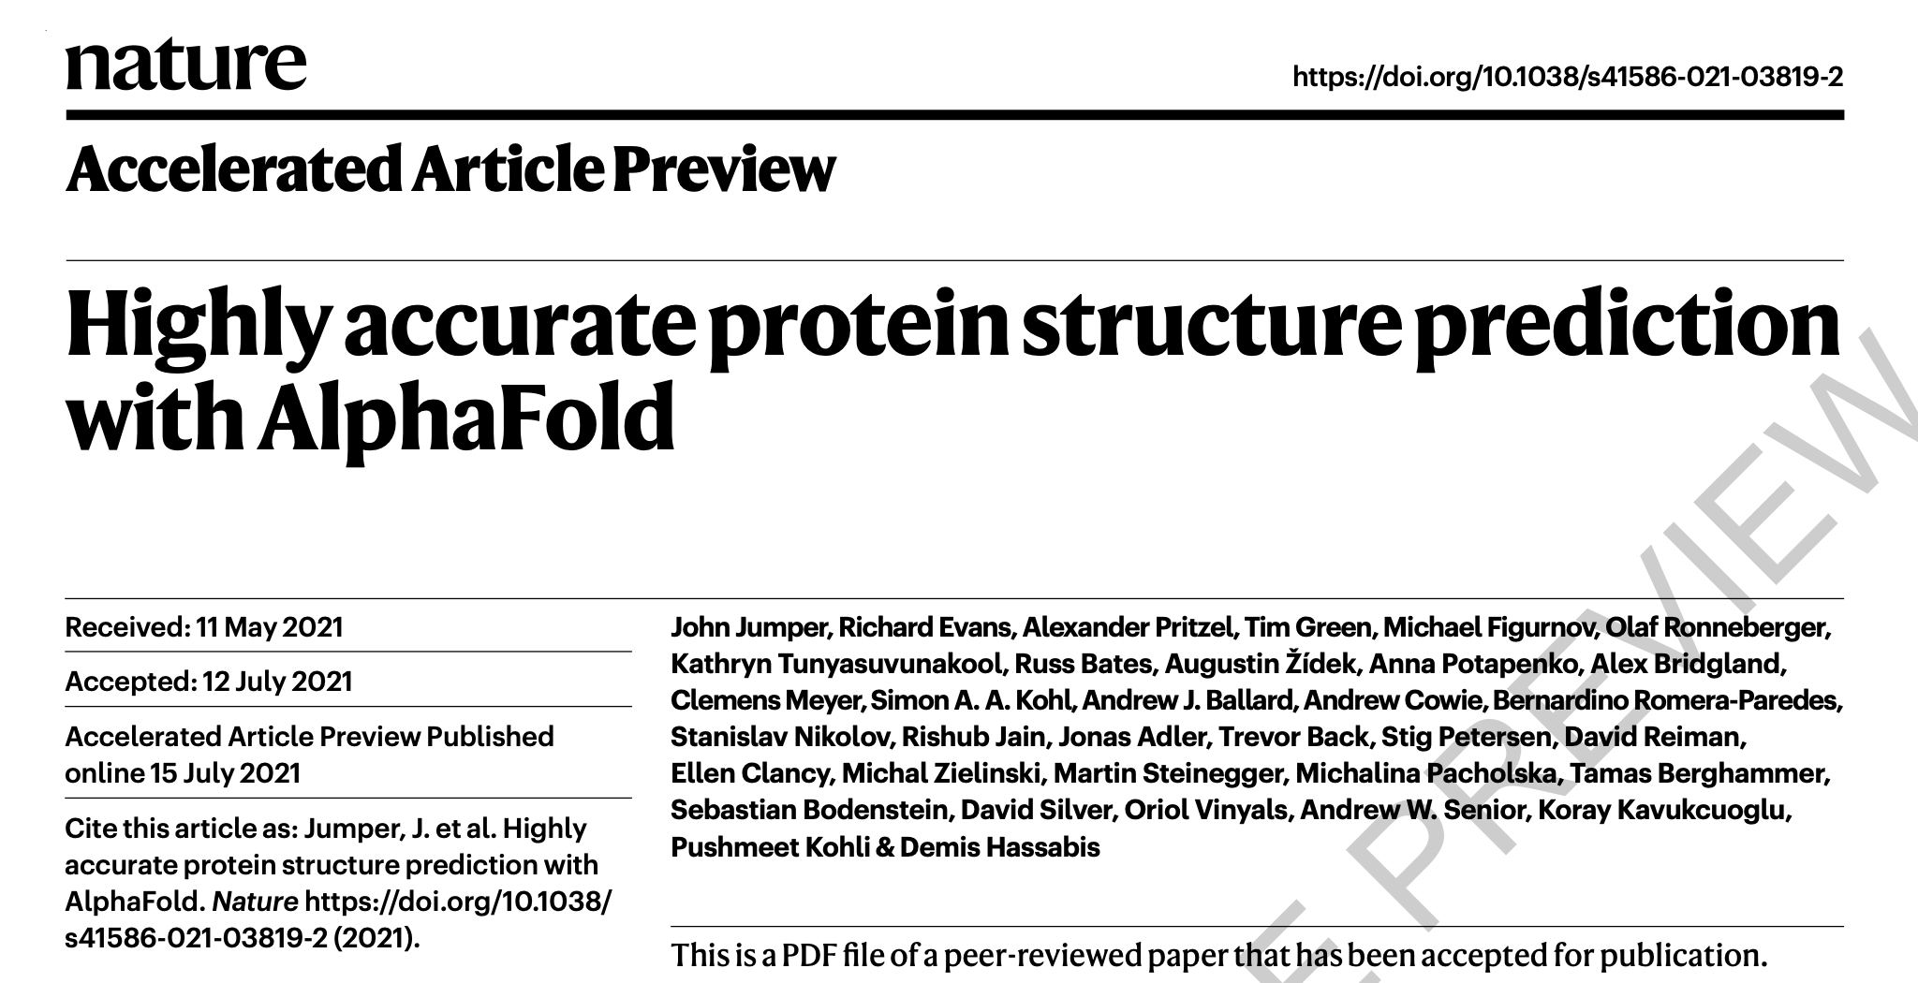
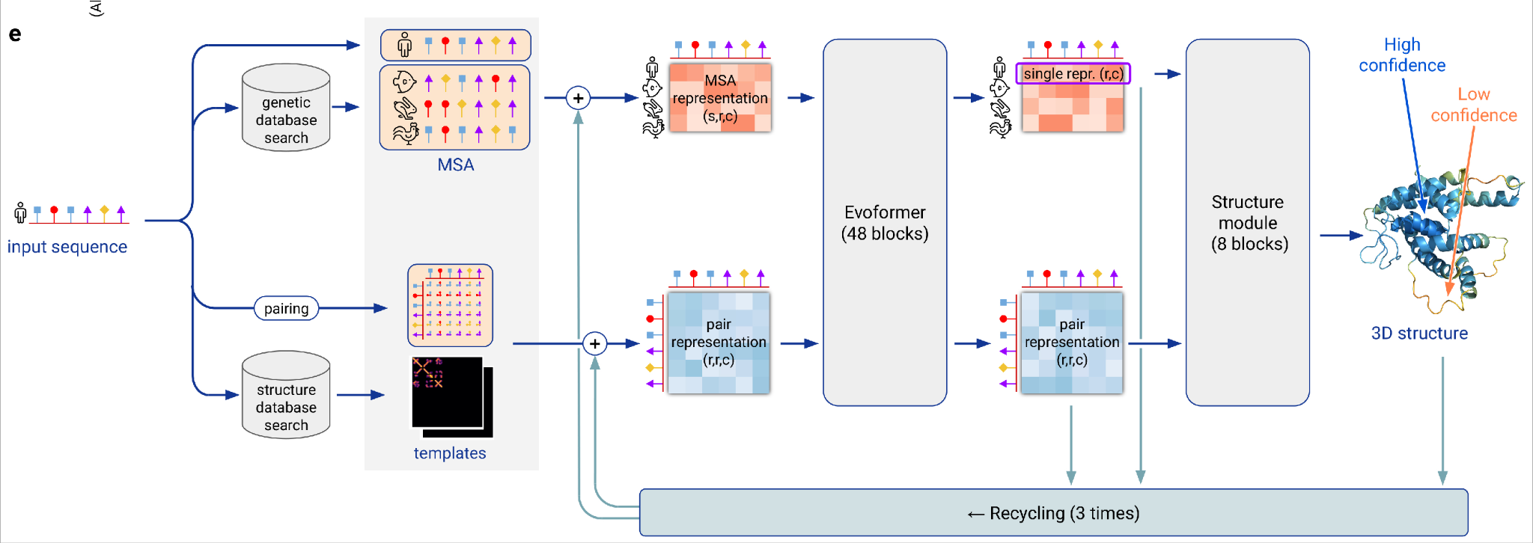

Slide 4
CASP11 (2014) - Typical pipeline
MSA = multiple sequence alignment
PSSM = Position-specific-scoring matrix
MRF = Markov Random Field (or Potts model)
seq DB
Sequence
MSA

Slide 5

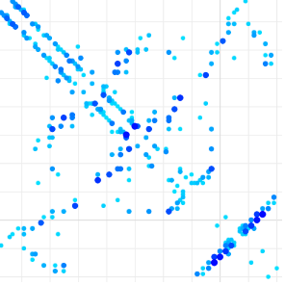
CASP11 (2014) - Typical pipeline
MSA = multiple sequence alignment
PSSM = Position-specific-scoring matrix
MRF = Markov Random Field (or Potts model)
seq DB
Sequence
MSA
Contacts
MRF

Slide 6
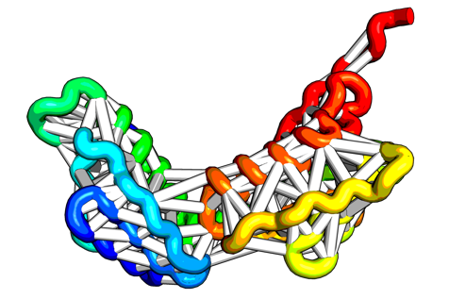
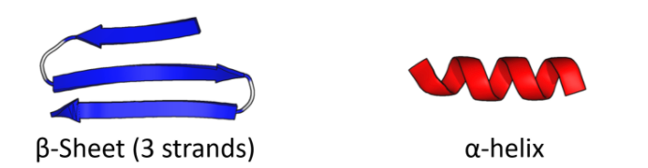
CASP11 (2014) - Typical pipeline
MSA = multiple sequence alignment
PSSM = Position-specific-scoring matrix
MRF = Markov Random Field (or Potts model)
seq DB
Sequence
MSA
Contacts
MRF
Folding
XYZ
Free Modeling (FM)
PSSM
2ndary Structure
Fragments
frag DB

Slide 7
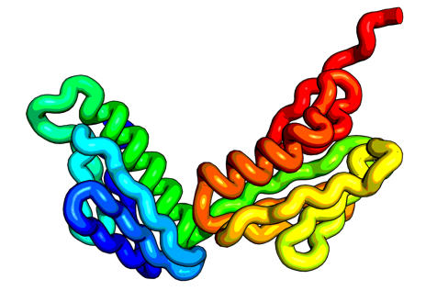
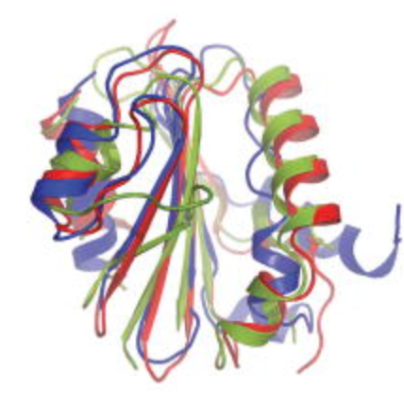
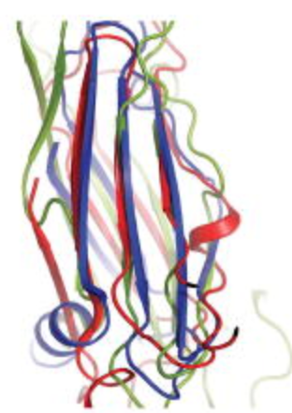
CASP11 (2014) - Typical pipeline
MSA = multiple sequence alignment
PSSM = Position-specific-scoring matrix
MRF = Markov Random Field (or Potts model)
seq DB
Sequence
MSA
Contacts
MRF
Folding
XYZ
Free Modeling (FM)
PSSM
2ndary Structure
Fragments
frag DB
pdb DB
Templates
Hybridize
XYZ
Template-based Modeling (TBM)

Slide 8
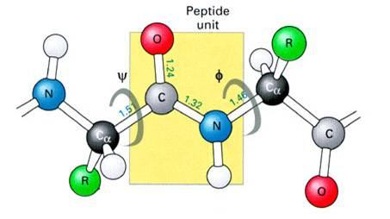
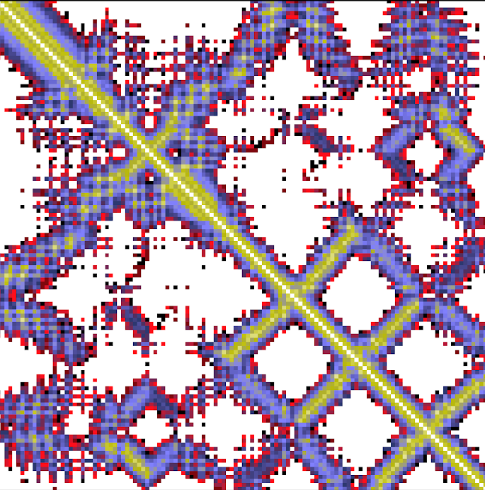
CASP13 (2018) - Alphafold1*
seq DB
ResNet
Dihedrals
Sequence
MSA
MRF
Distances
XYZ
Minimize
Folding
XYZ
PSSM
frag DB
Fragments
VAE
* Past researchers used raw MRF features, and ResNets: - Golkov, V., Skwark, M.J., Golkov, A., Dosovitskiy, A., Brox, T., Meiler, J. and Cremers, D., 2016, December. Protein contact prediction from amino acid co-evolution using convolutional networks for graph-valued images. In NIPS (pp. 4215-4223). - Wang, S., Sun, S., Li, Z., Zhang, R. and Xu, J., 2017. Accurate de novo prediction of protein contact map by ultra-deep learning model. PLoS computational biology, 13(1), p.e1005324.

Slide 9
CASP14 (2020) - Alphafold2*
seq DB
MSA
Module
Structure Module
Sequence
MSA
initial
XYZ
XYZ
PSSM
pdb DB
Templates
* Past researchers used raw Templates as input and/or did End2End Analysis of distance‐based protein structure prediction by deep learning in CASP13 - Jinbo Xu et al.
End-to-End Differentiable Learning of Protein Structure - Mohammed AlQuraishi Learning Protein Structure with a Differentiable Simulator - John Ingraham et al.

Slide 10
Alphafold2 - New Critical detail Recycling
seq DB
MSA
Module
Structure Module
Sequence
MSA
000
XYZ
PSSM
Recycle
pdb DB
Templates

Slide 11
Structure Prediction is only as good as the input MSA
seq DB
MSA
Module
Structure Module
Sequence
MSA
000
XYZ
PSSM
Recycle
pdb DB
Templates

Slide 12
What is a Multiple Sequence Alignment (MSA)?

Slide 13
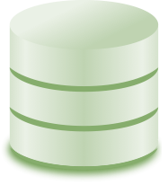
Search against a database of sequences
Search
Database of sequences

Slide 14
Generate a multiple sequence alignment
Search
Database of sequences

Slide 15
Analyze the MSA for coevolution
Coevolution

Slide 16
Use the as restraints in folding simulations!
Coevolution
Structure

Slide 17

Input feature generation for AlphaFold2
Input MSA features
Input Templates features
Iterative
search
BFD
Mgnify
UniRef90
PDB70
jackhmmer
HHblits
HHsearch
Generation of input features can take hours for a single protein on multiple cores

Slide 18




In ColabFold we replace the expensive MSA input generation using MMseqs2
k-mer-based
prefilter
10⁹ sequences
10⁴ sequences
MMseqs2 key ideas
Match long & similar k-mers
Two k-mer matches without gap in-between
DB sequence
Sequence profiles / iterative searches
Query sequence
Steinegger and Söding, Nature Biotechnol., 2017
github.com/soedinglab/MMseqs2

Slide 19
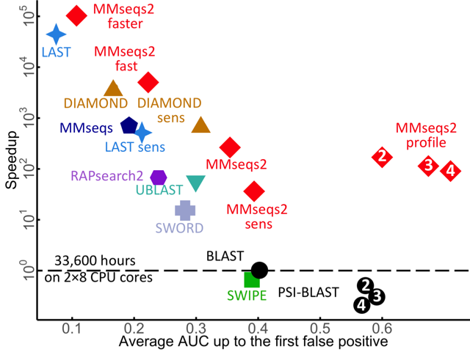
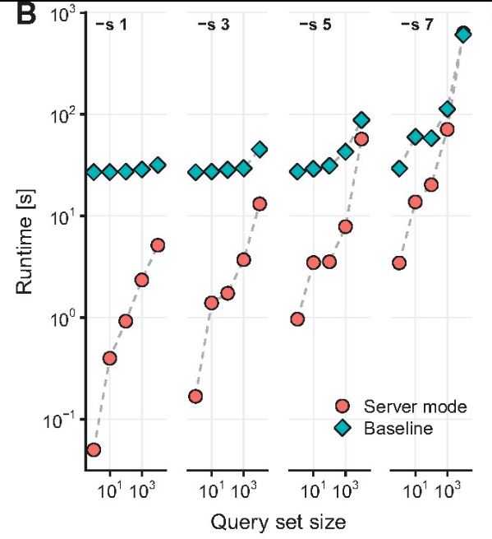
MMseqs2 is fast and sensitive Its server mode queries large sequence sets in seconds
More sensitive
Sequence
search
Profile
search
10²
Faster
Runtime [seconds]
10¹
10⁰
10⁻¹
10¹
10³
10¹
10³
Searched queries

Slide 20
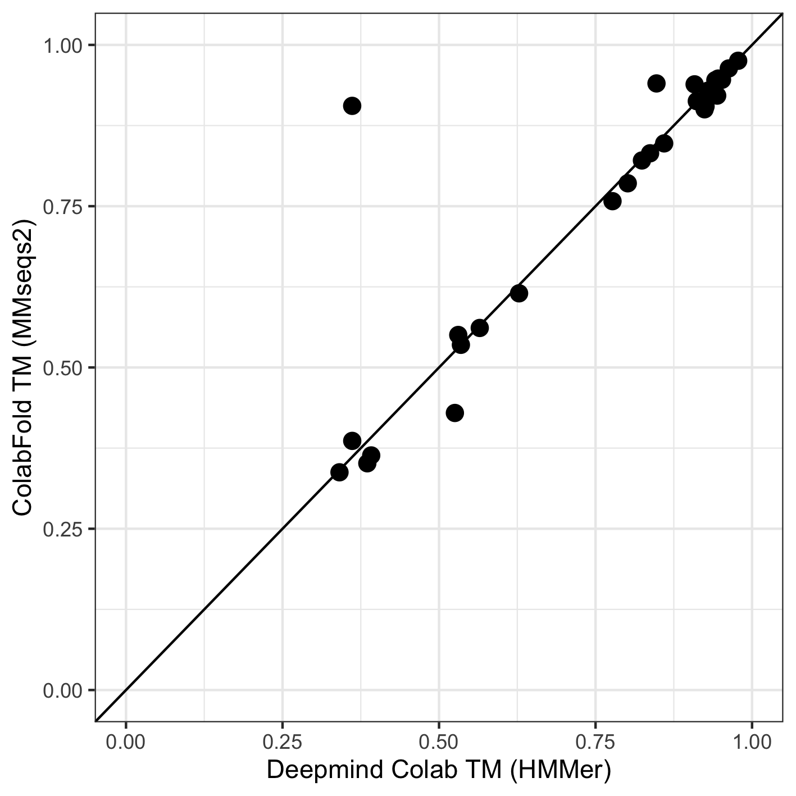
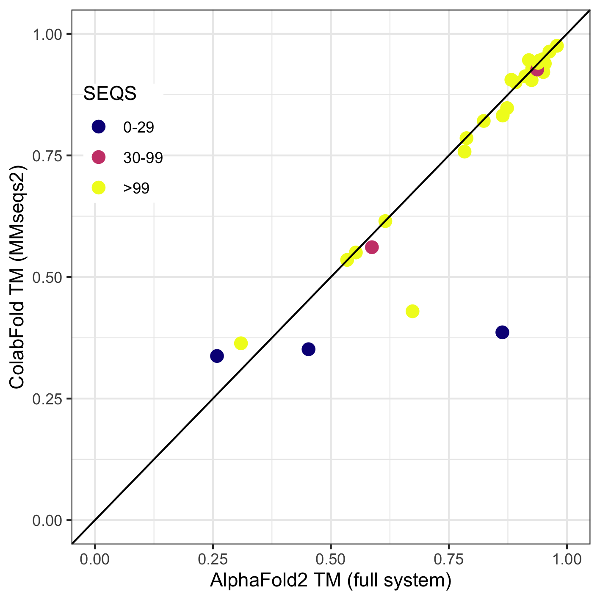
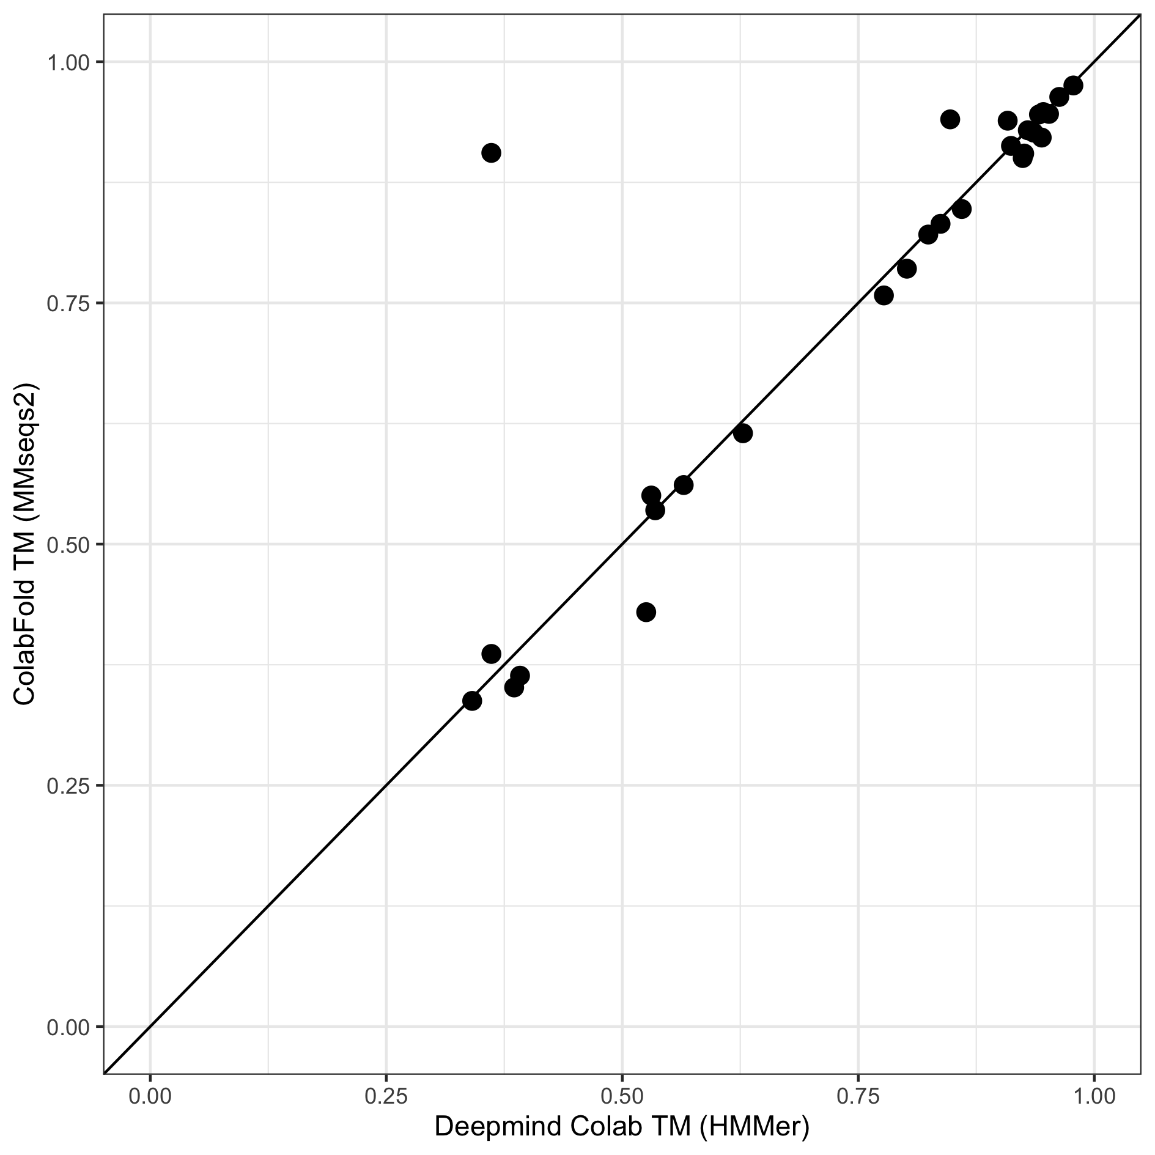
ColabFold (MMseqs2) performs similar to the full Deepmind Colab and the AlphaFold2 system on CASP14-FM
Sequences in MSA
(no templates)
(no templates)
(with templates)
Generation of MSA for all 20 sequence take <4 minutes on one core
Notes:
Evaluation on the domains (28 domains) of 20 chains.
"Check if templates were turned off"

Slide 21

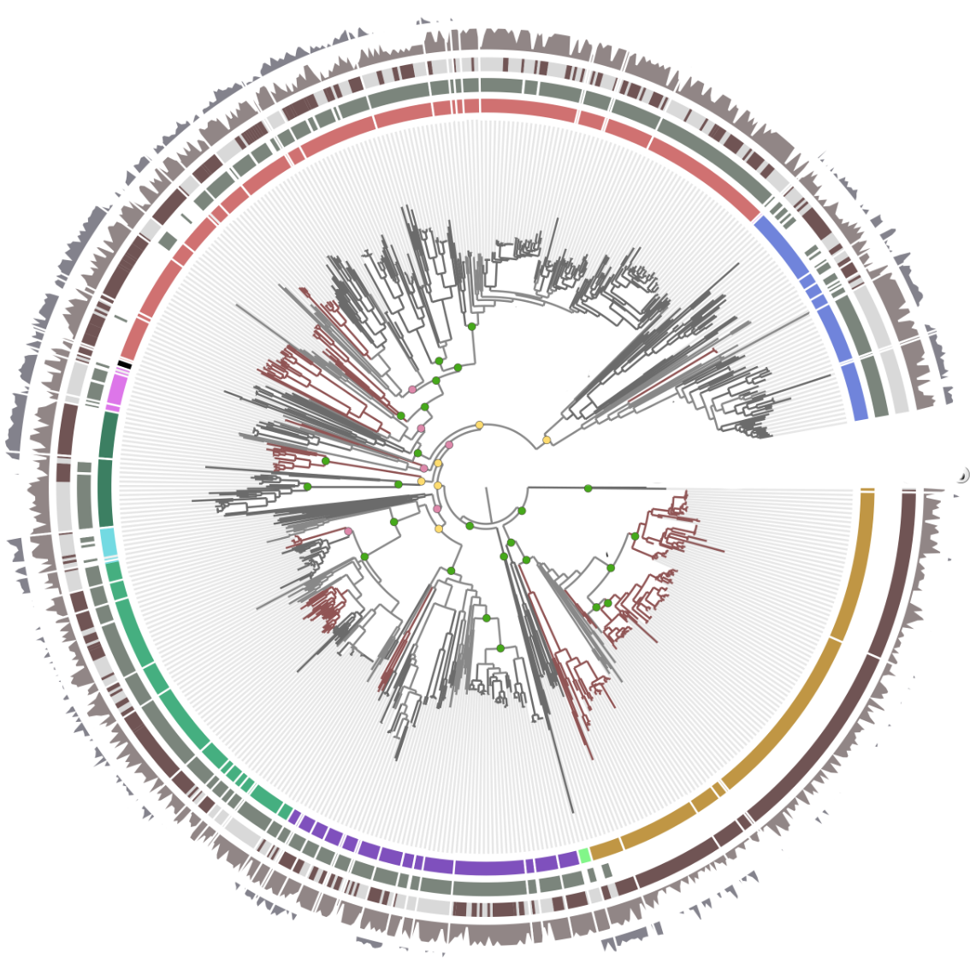


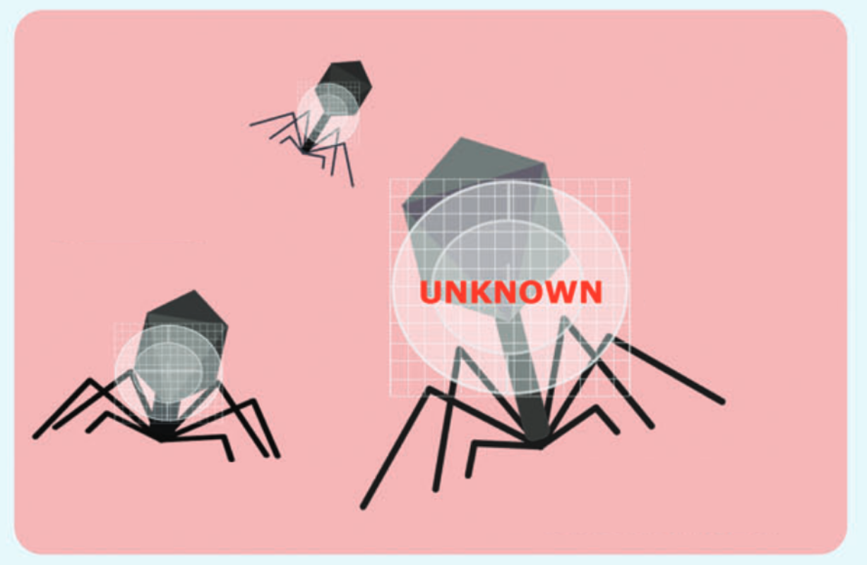

Constructing a huge environmental database for MSAs
Clustering with MMseqs2 at 30% seq.id.
Upcoming
SMAG
Metaclust2
GPD
BFD
and many more!
>2 Billion Proteins (BFD) Jumper et al., Nature, 2021
>1 Billion Proteins (Mgnify) Mitchell et al., Nucleic Acids Research, 2019
6 Mio Eukaryotic Proteins (Metaeuk) Levy Karin et al, Microbiome, 2020
10 Mio Proteins from SAGs and MAGs (SMAG) Delmont et al. biorxiv, 2021
Coming soon:
12 Mio Eukaryotic Proteins (TOPAZ) Alexander et al. biorxiv, 2021
11,8 Mio Viral Proteins (MGV) Nayfach et al. Nature Microbiology, 2021
7.5 Mio Phage Viral Proteins (GPD) Camarillo-Guerrero et al. Cell, 2021
36 Billion Proteins Metaclust2, unpublished

Slide 22
Intended and unintended uses
(aka. Twitter or Open Science)

Slide 23
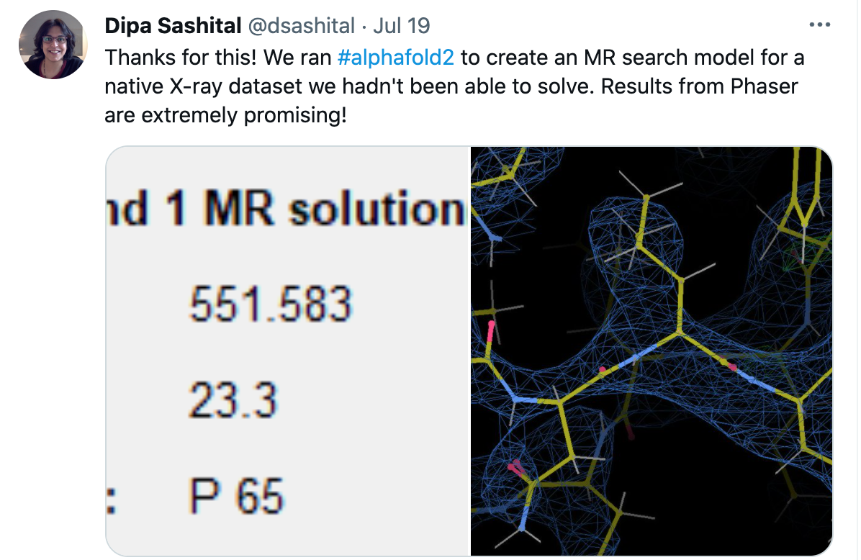
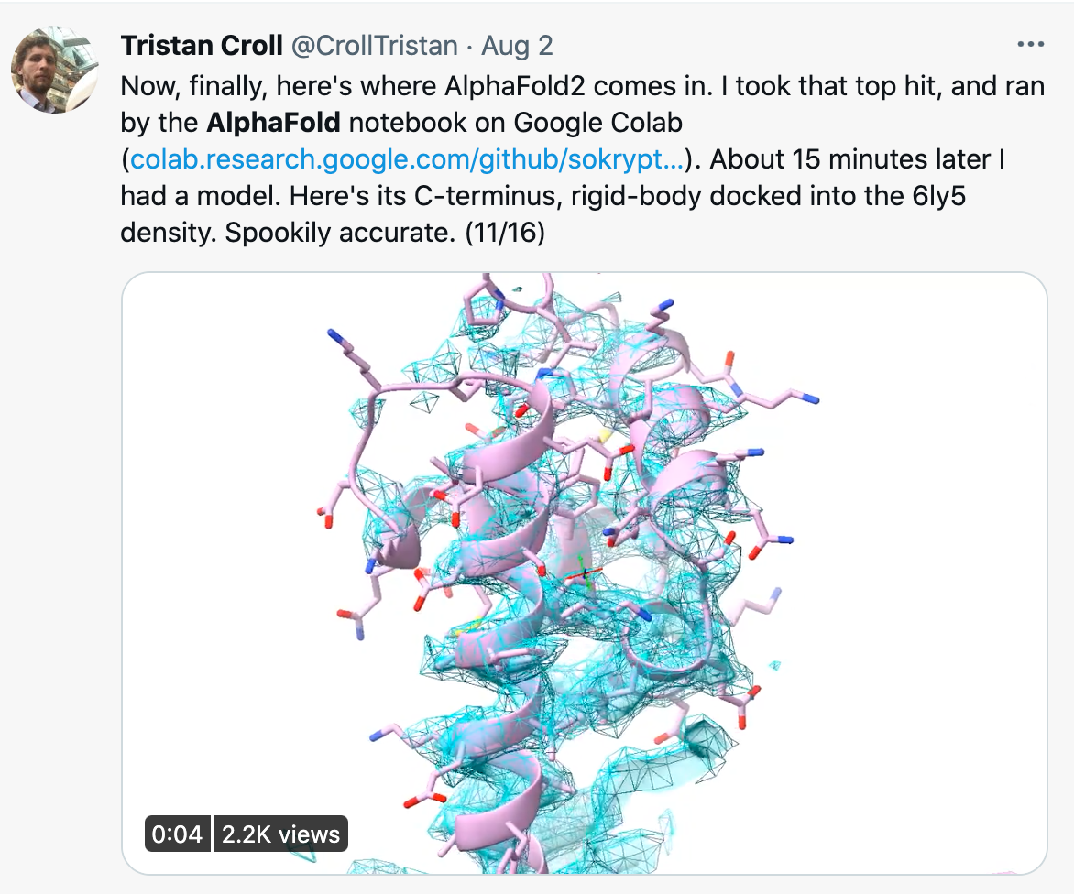
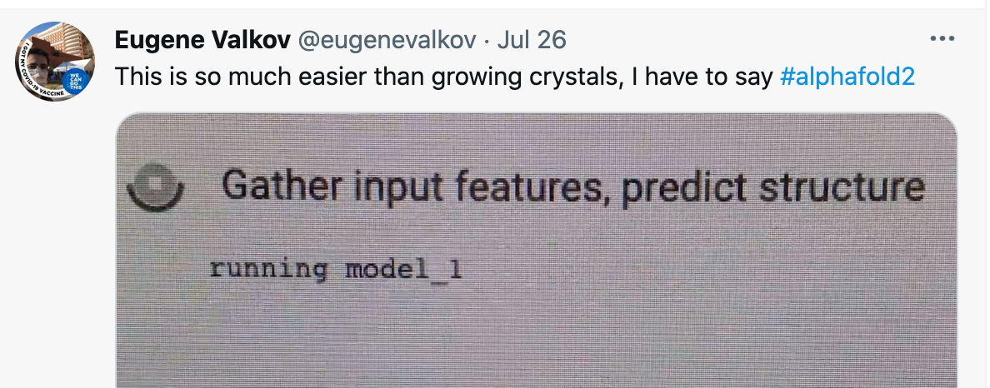
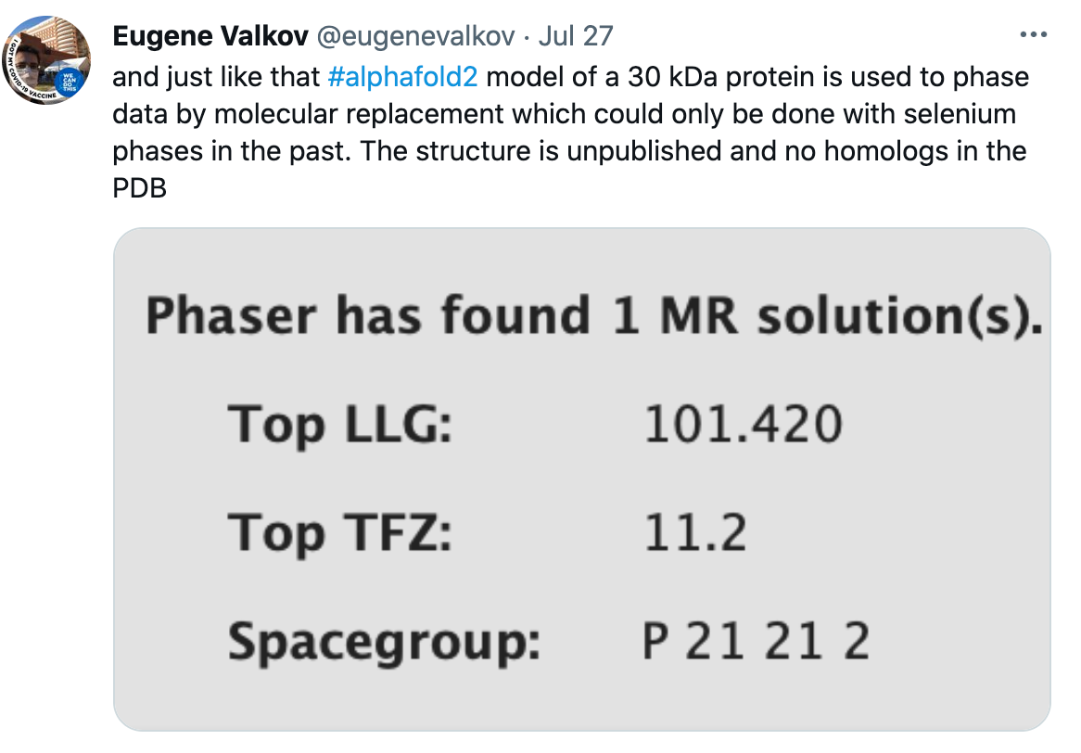
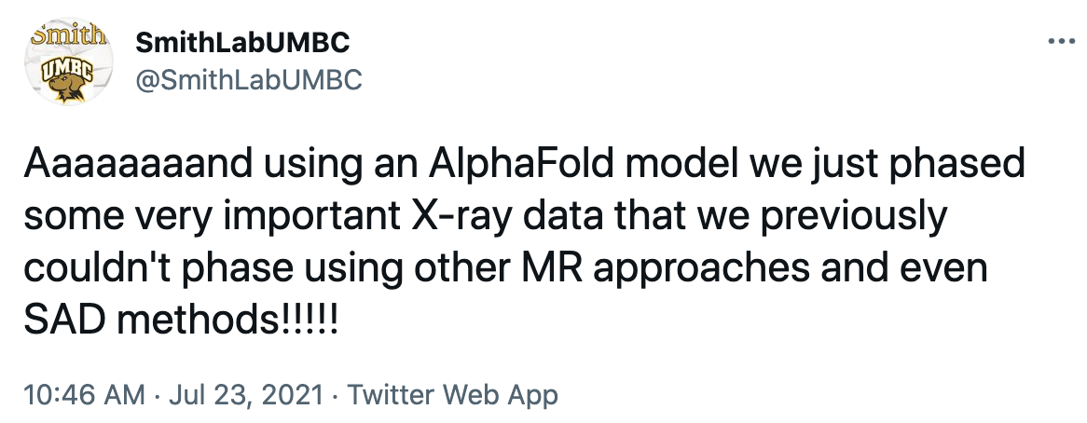
Molecular replacement / Model building

Slide 24
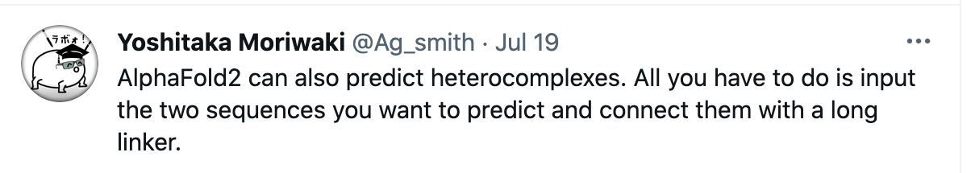
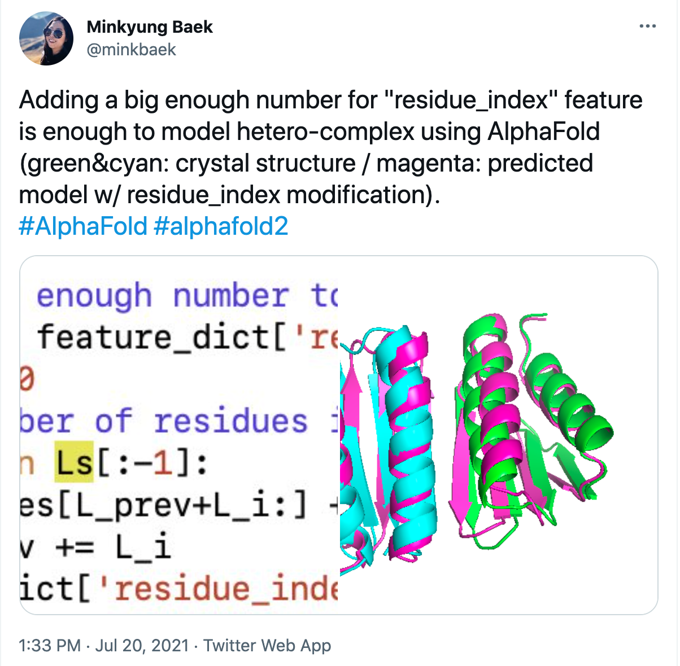
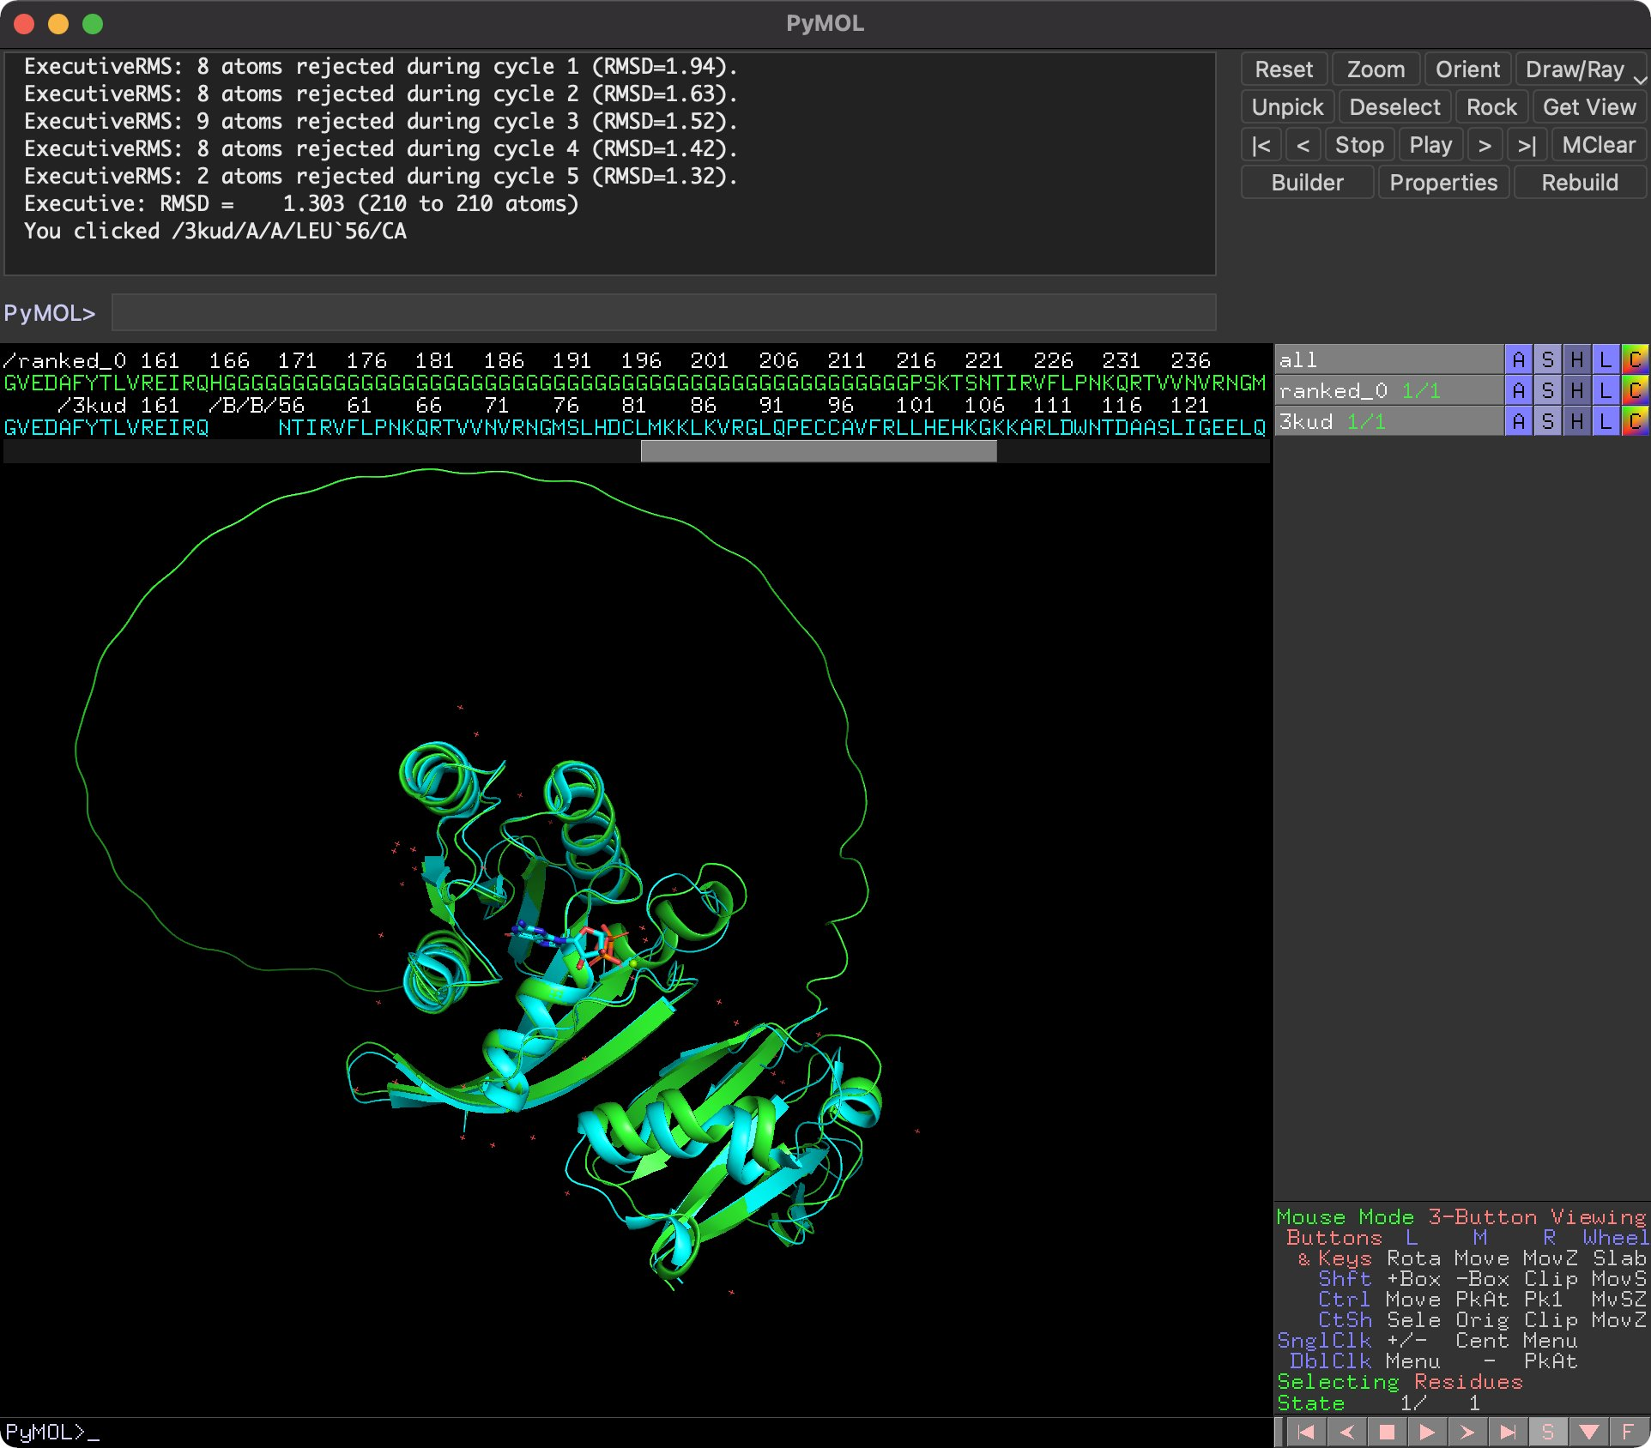
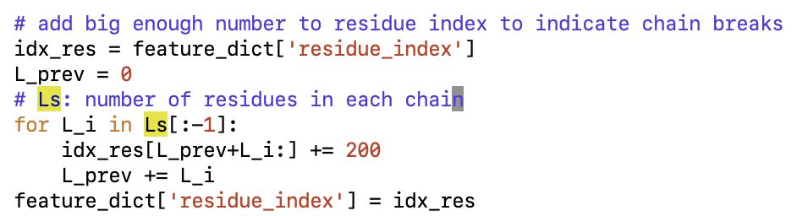
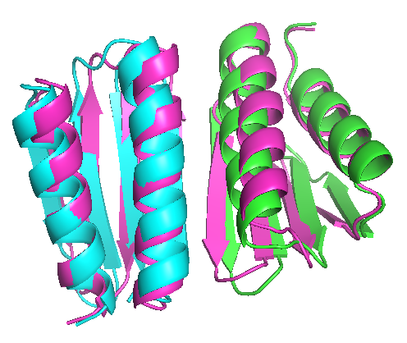
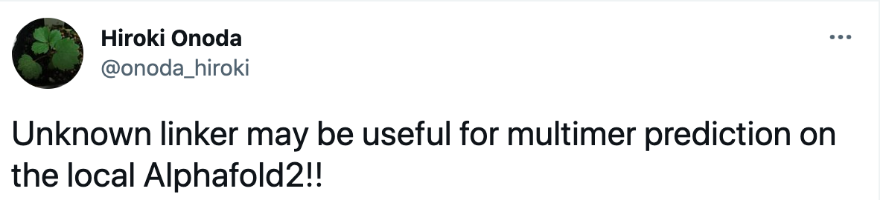
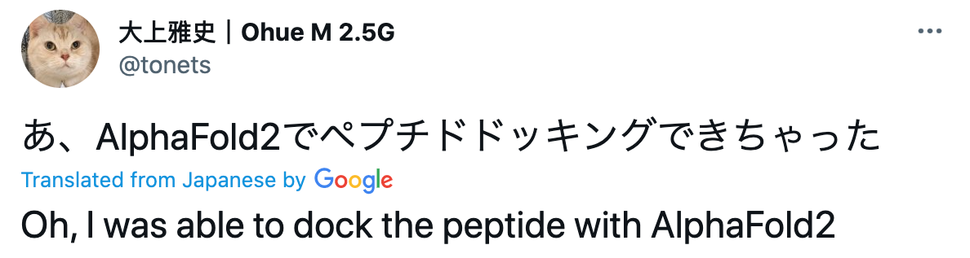
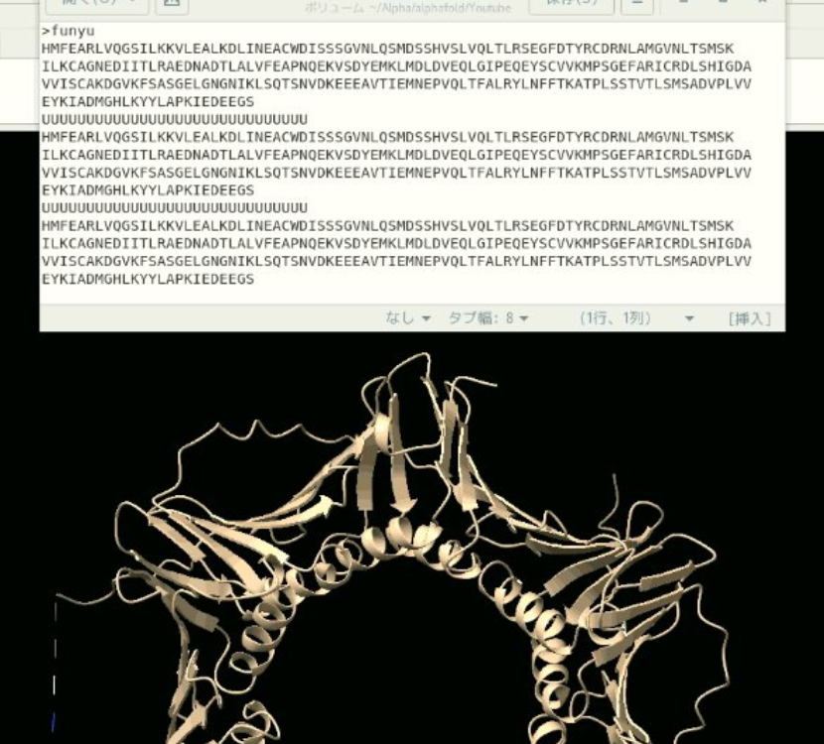
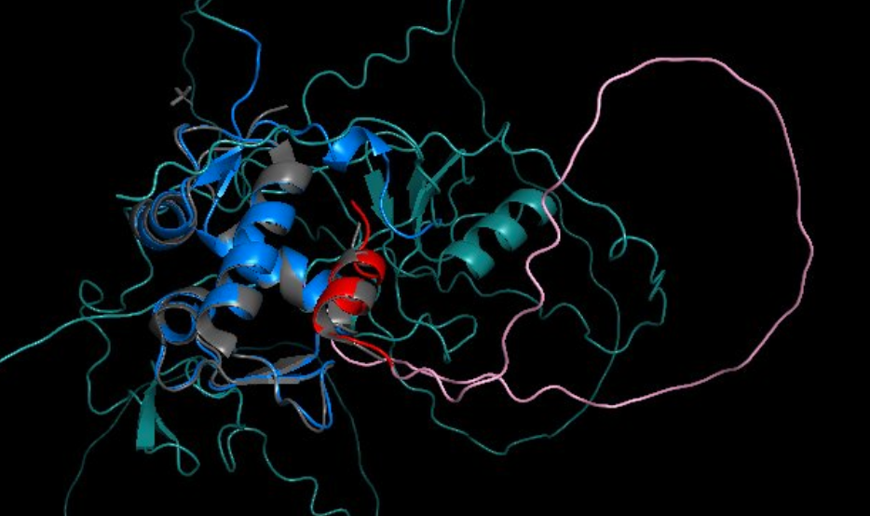
Can predict protein-protein/peptide interactions
Don't actually need a G-linker!
G-linker!
UNK-linker!
Protein-peptide interaction

Slide 25
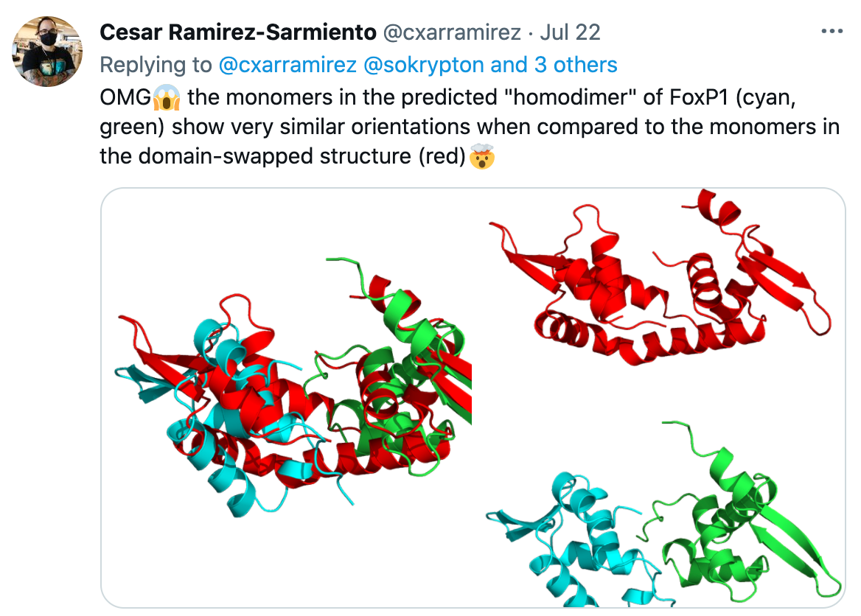
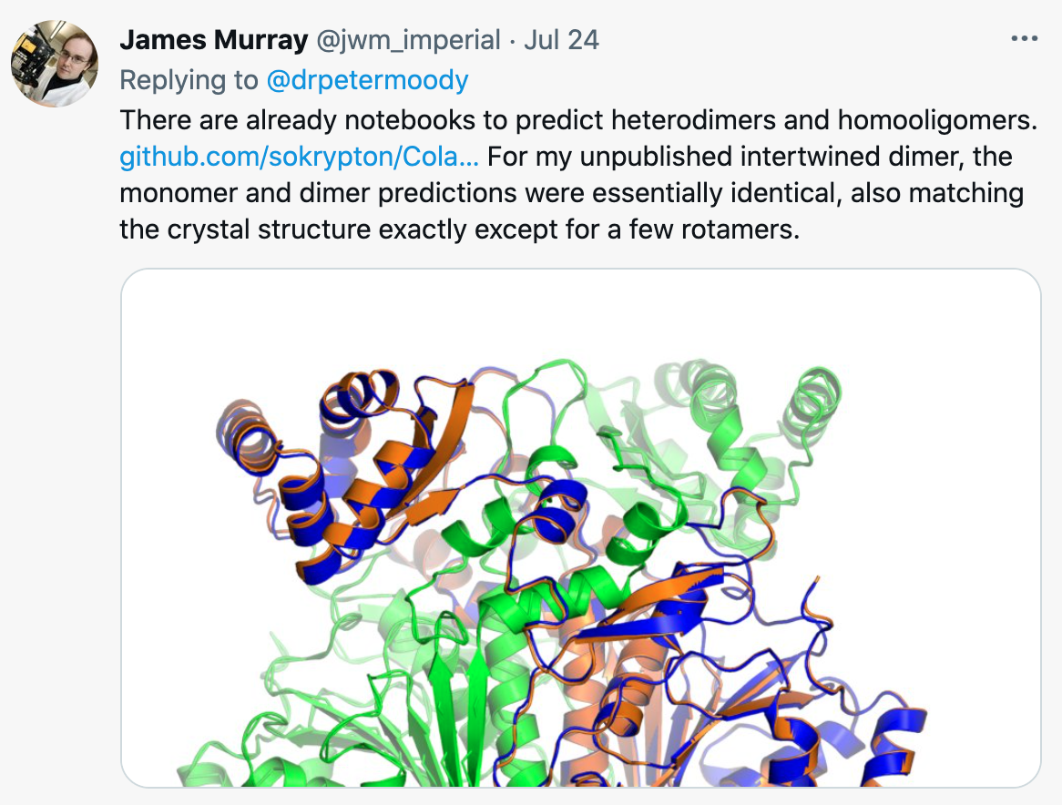
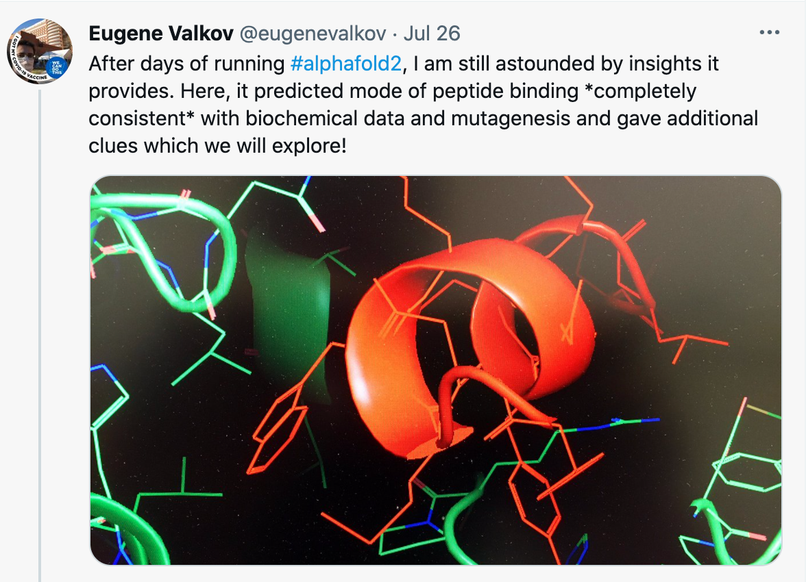
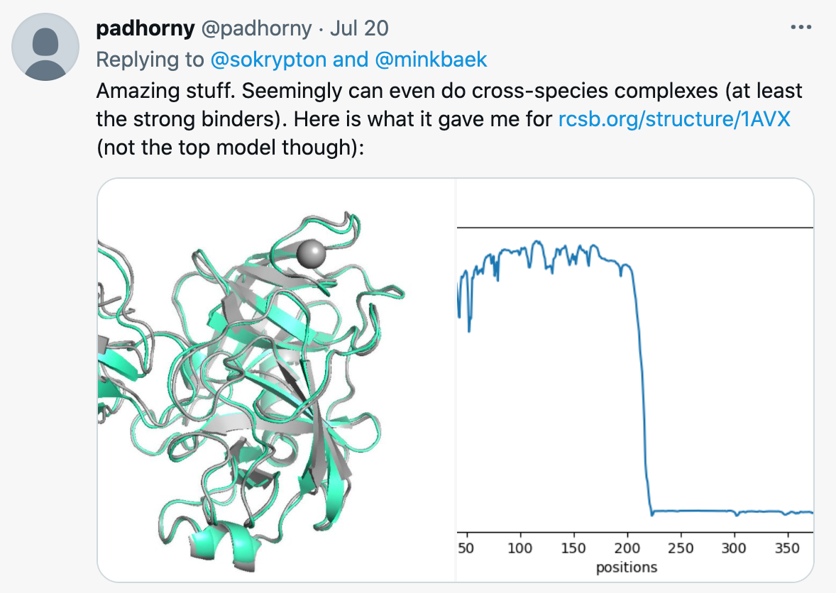
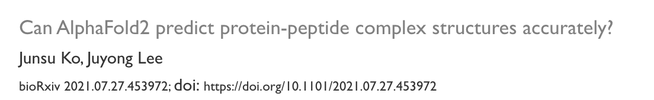
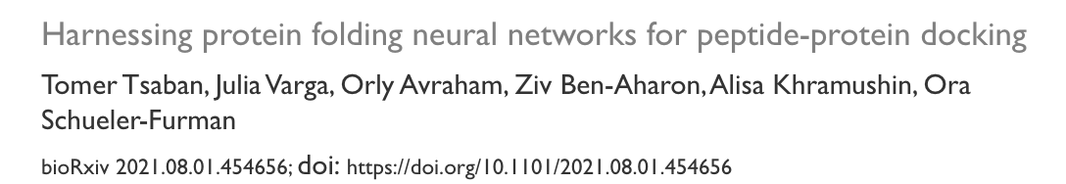
Can predict protein-protein/peptide interactions
dimer-swap
intertwined dimer
consistent w/ biochem data
Cross-spieces
Preprints rolling in...

Slide 26
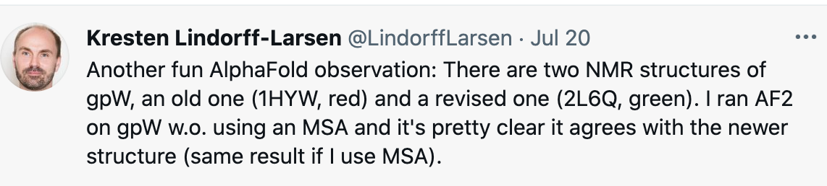
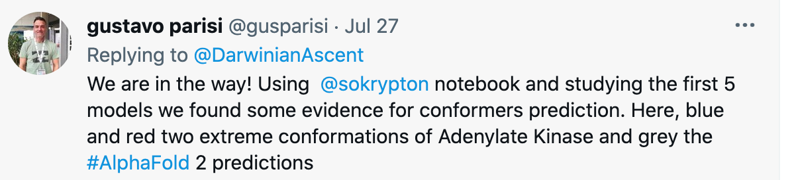
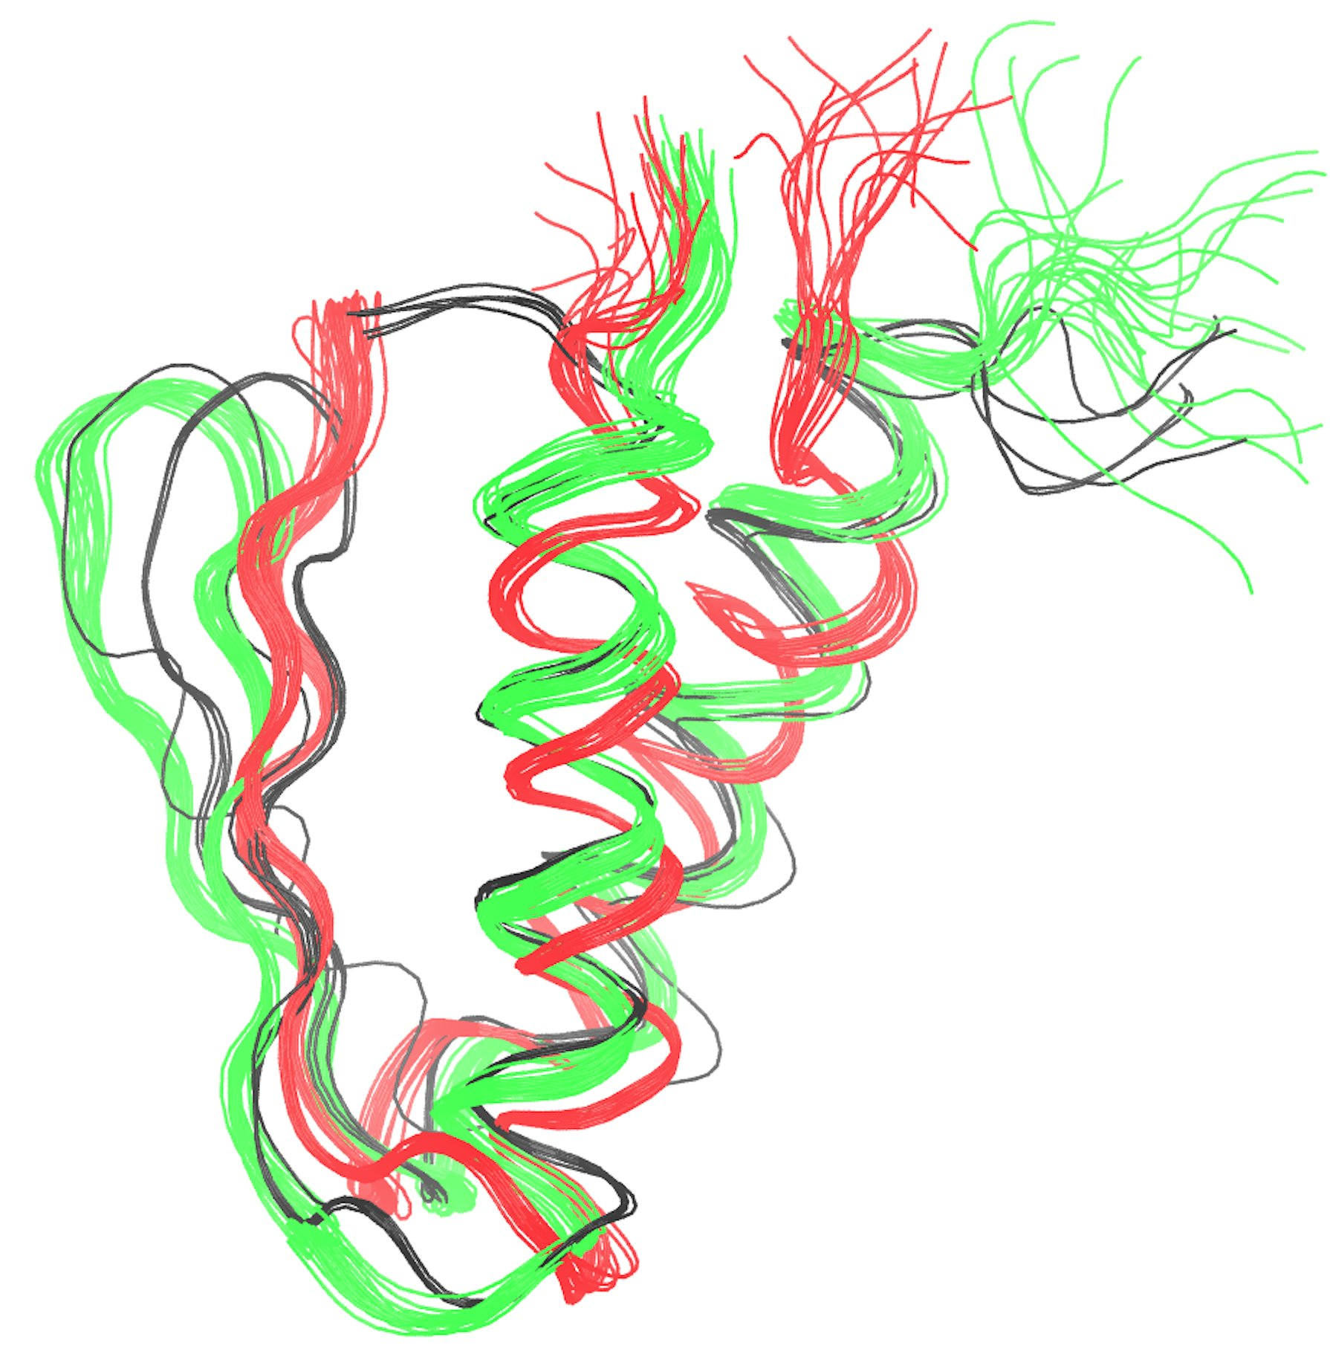
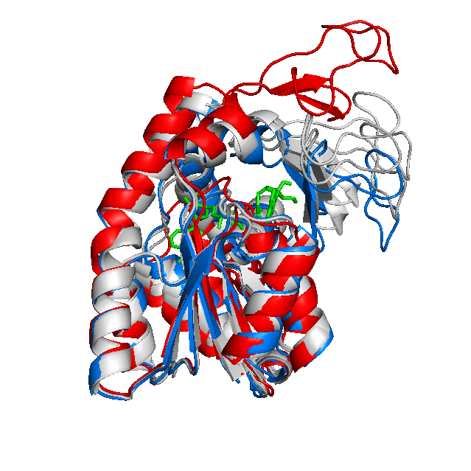
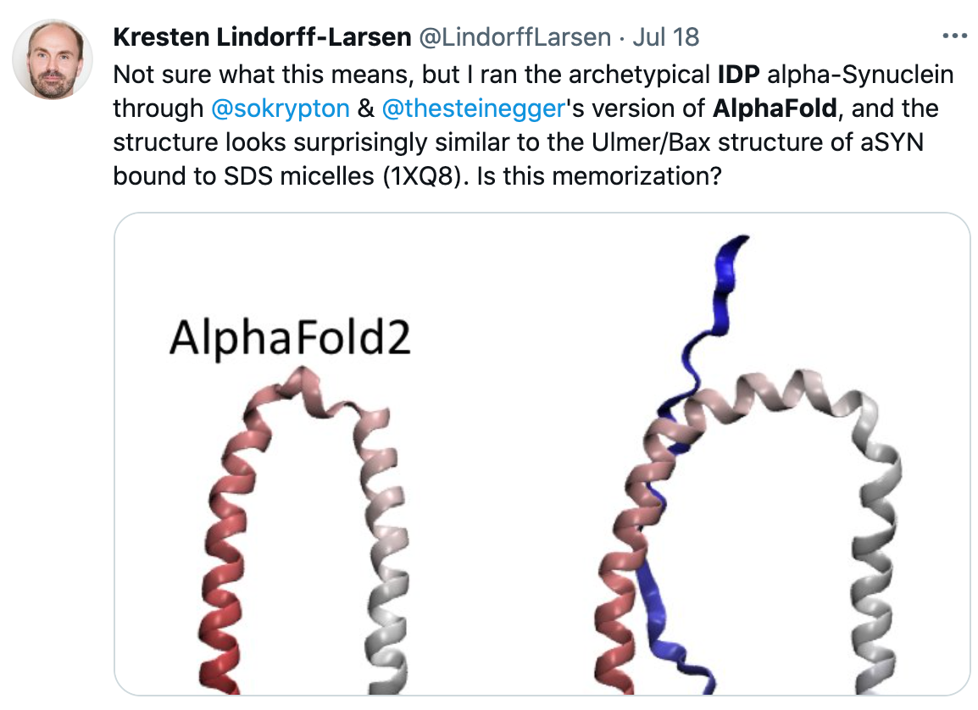
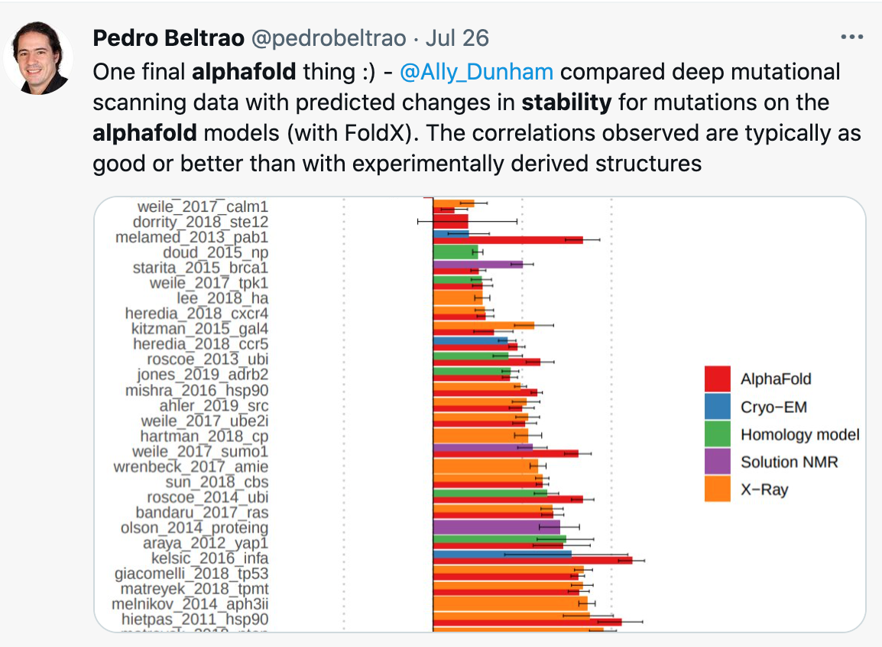
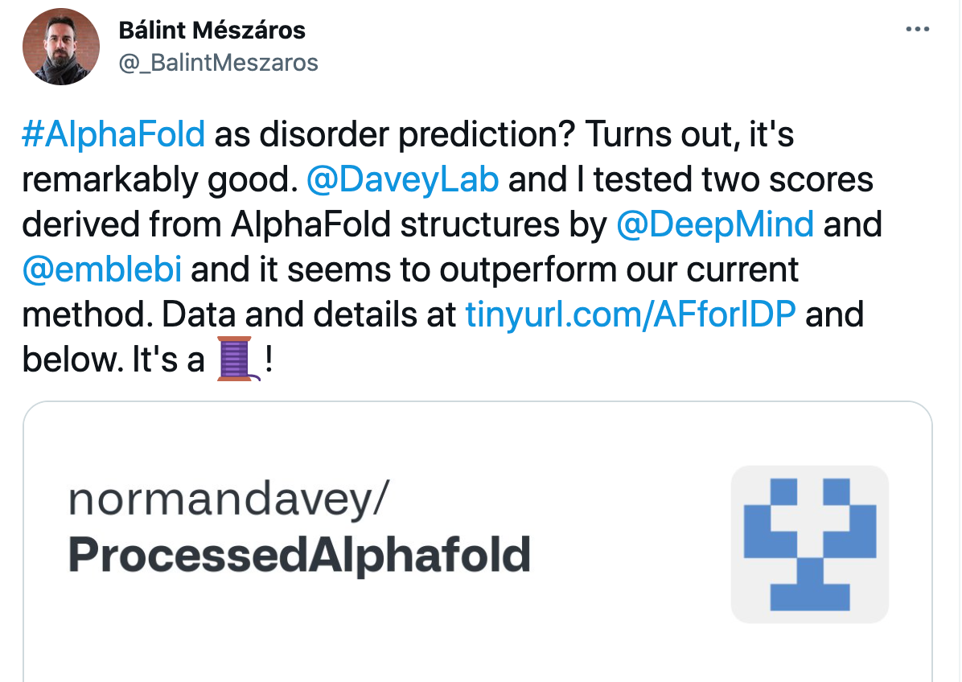
Others
Validate sketchy NMR experiments?
Capturing protein dynamics?
stability prediction?
IDP?

Slide 27

Also works in RoseTTAFold
Accurate prediction of protein structures and interactions using a three-track neural network
https://science.sciencemag.org/content/early/2021/07/19/science.abj8754

Slide 28
Intermission

Slide 29


Homo-oligomeric predictions

Slide 30
Surprising finding about input MSA
This does NOT work:
AAAAAAAAAAAAAaaaaaaaaaaaaa AAAAAAAAAAAAAaaaaaaaaaaaaa AAAAAAAAAAAAAaaaaaaaaaaaaa This works:
AAAAAAAAAAAAAaaaaaaaaaaaaa AAAAAAAAAAAAA------------- AAAAAAAAAAAAA------------- -------------aaaaaaaaaaaaa -------------aaaaaaaaaaaaa
The break is introduced by modifying the residue index:

Slide 31


Modeling as complex can fix details in monomers
pink = monomer model
white = homo-dimer model

Slide 32



G-linker can get in the way
no-linker worked!
failed when modelled with G-linker

Slide 33

Can determine oligomeric state by looking at Predicted Alignment Error (PAE)?

Slide 34
Doesn't always work...

Slide 35



Slide 36



Slide 37



Slide 38




Slide 39


when given 8 copies, predicted as a homo-8-mer instead homo-6-mer

Slide 40


Hetero-oligomer - Alignments
Works:
AAAAAAAAAAAAABBBBBBBBBBBBB AAAAAAAAAAAAABBBBBBBBBBBBB AAAAAAAAAAAAABBBBBBBBBBBBB AAAAAAAAAAAAABBBBBBBBBBBBB Often still works!
AAAAAAAAAAAAABBBBBBBBBBBBB AAAAAAAAAAAAA------------- AAAAAAAAAAAAA------------- -------------BBBBBBBBBBBBB -------------BBBBBBBBBBBBB
unpaired doesn't always work

Slide 41
Alphafold2 - Recycling
seq DB
MSA
Module
Structure Module
Sequence
MSA
000
XYZ
PSSM
Recycle
pdb DB
Templates

Slide 42


homooligomeric assembly with increased number of recycles
Credit Ryan Kibler

Slide 43








For denovo designed transmembrane protein: need more than 3 recycles!
recycle 1
recycle 2
recycle 3
recycle 4
recycle 5
Vorobieva, A.A., White, P., Liang, B., Horne, J.E., Bera, A.K., Chow, C.M., Gerben, S., Marx, S., Kang, A., Stiving, A.Q. and Harvey, S.R., 2021. De novo design of transmembrane β barrels. Science, 371(6531).

Slide 44

Another example: need up to 12 recycles to get the correct fold
Vorobieva, A.A., White, P., Liang, B., Horne, J.E., Bera, A.K., Chow, C.M., Gerben, S., Marx, S., Kang, A., Stiving, A.Q. and Harvey, S.R., 2021. De novo design of transmembrane β barrels. Science, 371(6531).
Notes:
Source code: https://colab.research.google.com/github/sokrypton/ColabFold/blob/main/beta/alphafold_output_at_each_recycle.ipynb

Slide 45

Changing the seed can give different results.
Protein with a knot, different seed value can change the outcome (knot or no knot)
seed 0
seed 1

Slide 46








Acknowledgments
Minkyung Beak, Ivan A. Justas D., Frank D.
Lim Heo
(initial analysis)
(RoseTTAFold support)
John Jumper & Tim Green
(Alphafold support)
David Koes
(py3Dmol)
Enzo Guerrero-Araya
(Submitting bug fixes)
Martin
Milot
Sergey

